Slide 1

DriverPass System Analysis
Marissa Lanza, aka, Luminita
6/21/2024
Notes:
[No speaker notes required for this slide.]

Slide 2

System Requirements
Functional Requirements:
User Authentication and Authorization: The system must authenticate users securely and authorize access based on their roles and permissions. This includes features like password protection, session management, and role-based access control.
Data Entry and Management: Users should be able to enter, store, retrieve, update, and delete data efficiently. This requirement ensures that the system supports CRUD (Create, Read, Update, Delete) operations for relevant data entities.
Nonfunctional Requirements:
Performance: The system must handle a minimum of 1000 concurrent users during peak hours without significant performance degradation. Response times for critical operations should be under 2 seconds to ensure user satisfaction.
Security: Data transmission must be encrypted using industry-standard protocols (e.g., TLS/SSL). The system should also implement measures to prevent unauthorized access, data breaches, and ensure compliance with relevant data protection regulations (e.g., GDPR, HIPAA).
These requirements provide a blend of functional capabilities and nonfunctional characteristics that are essential for designing and evaluating the system's performance and usability.
Notes:
DriverPass has many requirements to run properly. As an example of functional requirements, DriverPass needs users to be able to register themselves. Users will need to enter information to create this account, but afterwards they can login to purchase packages, schedule appointments, and study. After users are logged in, they need to be able to access DMV documents via our site. We will need to setup an API that requests the latest documents from the DMV for users to study.
As an example for nonfunctional requirements, the website will need internal and/or external storage to save website and database data. This is necessary so that when a user has finished their session, the website will store the data so that it’s still there the next time they login. Lastly, users need the ability to reset their own password. We could verify them via an email, and send them a reset link so that employees don’t need to reset the user’s password each time.

Slide 3
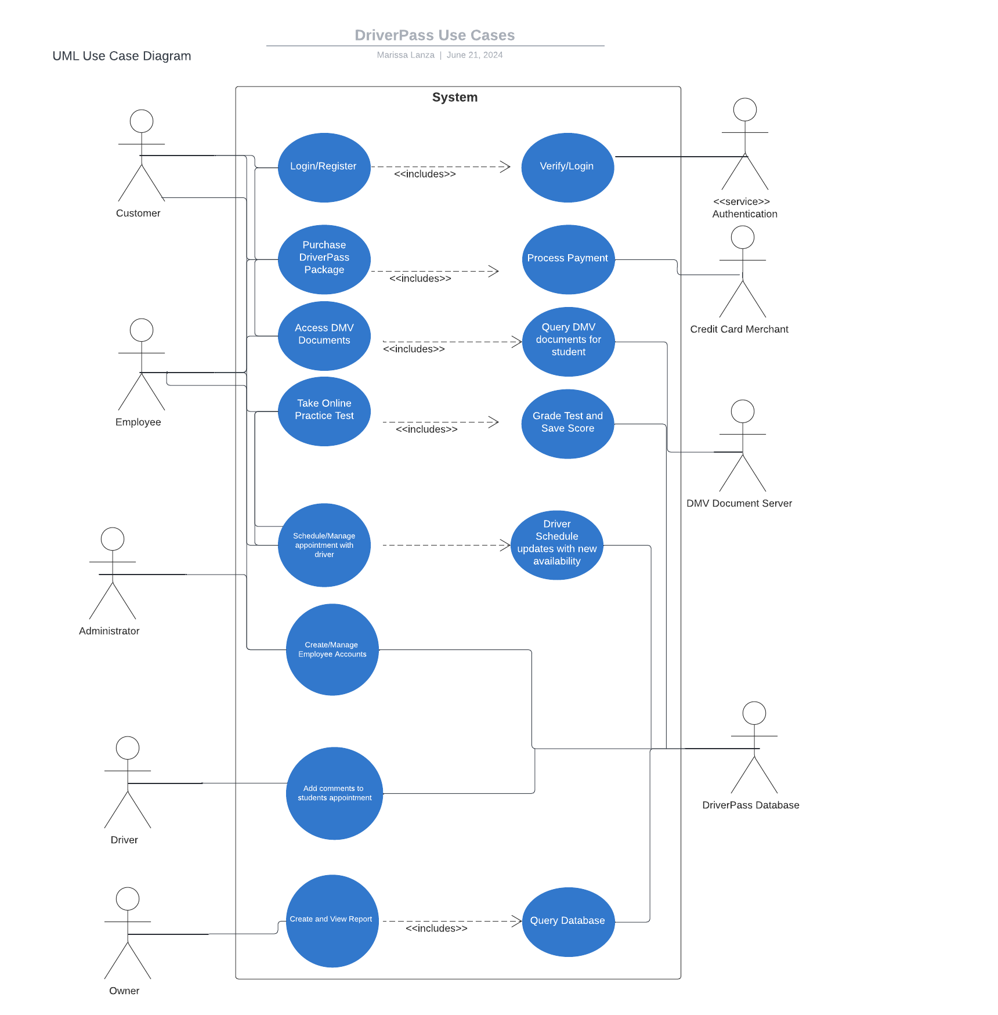
Use Case Diagram
Notes:
This diagram shows the various uses for the DriverPass application. Certain people will utilize certain functions. We start with the customer, who will need access to functions like creating an account, purchasing packages, accessing documents, etc… Next, the employee will also have this ability so they can setup appointments for customers. Administrators of the website need the ability to create and manage employee accounts. The driving instructors will need to add comments to the customer’s driving. Lastly, the owner needs the ability to create and view reports. There are then functions that the users won’t see, like verify login which is done by an authentication service. Processing the user’s payment through the credit card merchant is another function that is activated when the user purchases a package. The DMV document server provides the most up-to-date documents for the customers to study. Finally, the DriverPass database stores information for reporting purposes.
This diagram was created with needs in mind. Their customers need the ability to manage their appointments and packages, preferably without the help of employees. But employees also need the abilityDriverPass’s to help customers through this process. Customers also need to study and take practice tests, which is where we get the use case for access DMV documents and take a practice test. DriverPass also needs the manager/owner to create reports so that they can view the efficiency of their employees and drivers.

Slide 4
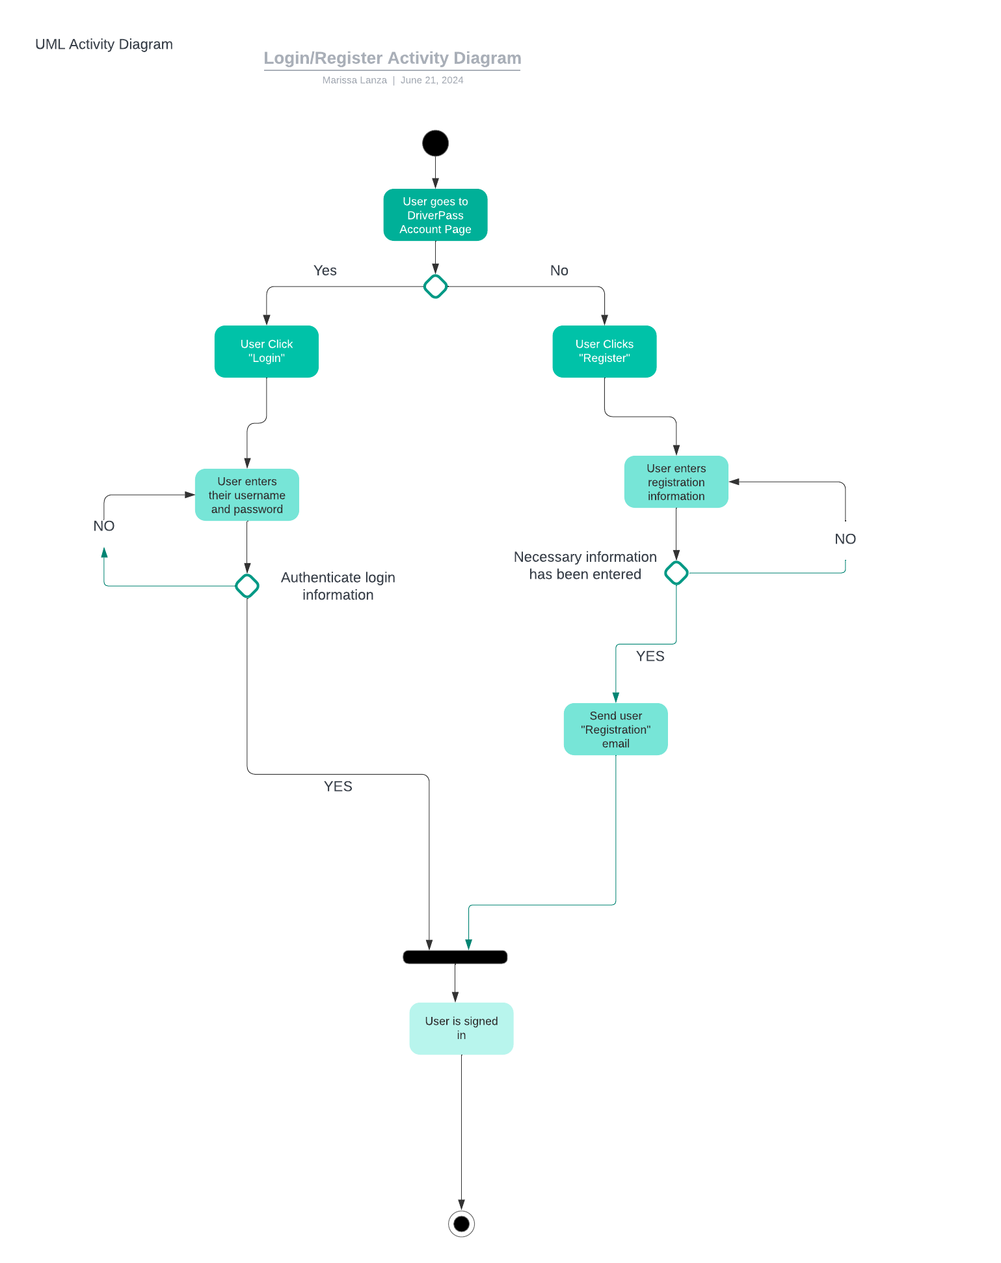
Activity Diagram
Notes:
The activity diagram breaks down the user login/register use case. First, the user goes to the DriverPass website and clicks a link to access their account. If the user doesn’t have an account, they’d click register. Otherwise, they simply click login. If the user clicks register, they need to enter all the necessary information, like their name, email, address, etc… The user would then receive a registration email. If the user clicks login, they will enter their username and password. If the login credentials aren’t authorized, they’d have to reenter their credentials. Otherwise, the user is logged in and can manage their account.
DriverPass requires a simple way for users to create an account, and they also need to be able to login to save their information. This requires authorization so that hackers can’t easily get into user accounts.

Slide 5
Security
Registered user must authenticate their email address
Users require a password to login
Authorization process stops “brute force” so hackers can’t easily login to user accounts
Website uses HTTPS rather than HTTP, so that sensitive information is sent encrypted
Notes:
One security feature we can add is having users register their email when the create an account. This would help stop bot accounts from being created, but it does add one extra step for the user. As is standard nowadays, users will require a password to access their account. This stops anyone from logging in as another user without the right password. Next, we can develop a limit to incorrect login attempts. For example, if a user doesn’t use the right password in 5 attempts, their account is locked for some amount of time, or until they call in. This would prevent “brute force” attacks from hackers, where they use a script to guess the password, but it usually takes thousands of attempts to get it. Lastly, the website will utilize HTTPS over HTTP. This way, when sensitive data like credit card numbers and client information is sent it is encrypted. This makes is more difficult for a hacker to steal data.

Slide 6
System Limitations
Customers in certain regions may have slower access to the website
The client doesn’t have an on-staff developer
Some client devices may not be able to open the website
Notes:
Customers in regions further from the data center may have a slower connection. They should still be able to access the site in good speed, but it could be significantly slower. Next, DriverPass doesn’t have an on-staff developer, which can be an issue if they want to change or update certain modules. For example, DriverPass may have to outsource a developer to add a new function to the application. Lastly, it’s possible that certain browsers/devices can’t access the site. This would be a rare situation, but it is possible.

